Slide 1
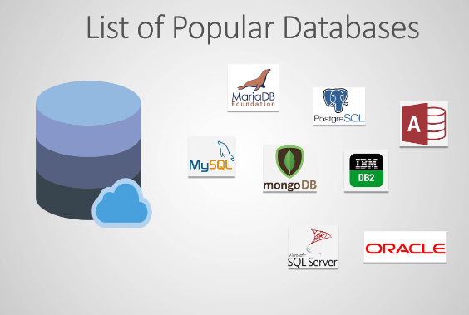
What is Database
A database server is a computer that stores and manages databases, and allows users to access them. It's a key component of client/server computing.

Slide 2
Types of database
Relational database (Sql)
A relational database (RDB) is a structured way of storing and managing data using tables that are related to each other. It is based on the relational model, where data is organized into rows (records) and columns (attributes) within tables.
Key Features of Relational Databases:
Tables (Relations) – Data is stored in structured tables.
Primary Keys – Unique identifiers for records in a table.
Foreign Keys – References to primary keys in another table to establish relationships.
SQL (Structured Query Language) – Used to query and manipulate data.
Example of a Relational Database:
Tables:
Customers Table
CustomerID
Name
Email
1
Alice
alice@mail.com
2
Bob
bob@mail.com
Orders Table
OrderID
CustomerID
Product
101
1
Laptop
102
2
Phone

Slide 3
Popular Relational Database Management Systems (RDBMS):
MySQL
PostgreSQL
Microsoft SQL Server
Oracle Database
SQLite

Slide 4
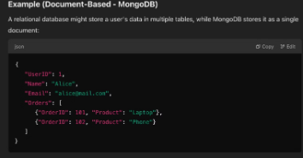
Non-Relational Databases
A non-relational database (also called a NoSQL database) is a type of database that does not use the traditional table-based relational model. Instead, it stores and manages data in flexible structures like documents, key-value pairs, graphs, or wide-column store
Key Features of Non-Relational Databases:
Flexible Schema – Unlike relational databases, NoSQL databases do not require a fixed table structure.
Scalability – Easily scales horizontally by distributing data across multiple servers.
High Performance – Optimized for large-scale and high-speed data retrieval.
Schema-less or Dynamic Schema – New data structures can be added without altering existing data.
CAP Theorem Considerations – Prioritizes Consistency, Availability, or Partition Tolerance depending on the database type.
Types of Non-Relational Databases:
Document-Based Databases 📄
Stores data as JSON or BSON documents.
Example: MongoDB, CouchDB
Use Case: Content management systems, e-commerce platforms.
Key-Value Stores 🔑
Data is stored as a key-value pair.
Example: Redis, DynamoDB, Riak
Use Case: Caching, session management.

Slide 5

MariaDB Database: An Overview
This presentation covers MariaDB database. We will explore its features and capabilities. We will also discuss installation, management, and optimization. Let's begin our journey into MariaDB.

Slide 6
MariaDB Database Installation
1 yum install mariadb-server -y
2 Start and enable its service named as mariadb.
3 Enable Port 3306/tcp (firewall-cmd - -permanent - -add-post=3306/tcp )
4 Restart firewalld service.

Slide 7
Secure Installation
1. Run the Secure Installation Script
sudo mysql_secure_installation
This script will guide you through the following security measures:
Set (or reset) the root password.
Remove anonymous users. (y)
Disable remote root login. (y)
Remove the test database. (y)
Reload privilege tables. (y)

Slide 8
Basic Commands for Management. (always use ;)
mysql -u root -p
show databases;
use mysql;
show tables;
describe user; (select any table index file as per need)
select user,host,password from user; (select content to want to watch)

Slide 9
How to create database
create database redhat; (redhat random name given)
show databases; (for check)
use redhat;
show tables;
drop database redhat; (to delete database)

Slide 10
Users in database
1. Security & Least Privilege Principle
The root user has full control over MariaDB, which is risky if compromised.
Creating separate users allows you to assign only necessary privileges, following the principle of least privilege.
Different applications and users require different levels of access.
Example: A web application might need SELECT, INSERT, UPDATE, and DELETE, but not DROP or ALTER.
By creating specific users, you minimize the risk of unintended changes.
2. Auditing & Tracking User Actions
Having multiple users helps track who made what changes to the database.
This is crucial for security audits and compliance.
Should I Ever Use the Root User?
Use root only for administrative tasks, like creating databases or users.
For everyday operations, always use restricted users.

Slide 11
Create users in database
create user shivam@localhost identified by '1234'; → By this we can create user for localhost access only, means from that user we cannot take remote access of the database.
create user shivam@'%' identified by '1234'; → By this we can create user for global purpose, means from that user we can take remote access of the database.
create user shivam@'IP' identified by '1234'; → only from the specific IP user can be access.
Check these users same way.
mysql -u root -p
show databases;
use mysql;
show tables;
describe user; (select any table index file as per need)
select user from user;

Slide 12
User Permissions
show grants for shivam@localhost; and show grants for shivam@'%'; → to check permission.
grant all on databasename. * to shivam@localhost;
grant create on databasename. * to shivam@'%';
revoke create on databasename.* from shivam@"%*;

Slide 13
Privileges
Privilege
Description
ALL PRIVILEGES
Grants all available privileges.
GRANT OPTION
Allows user to grant privileges to others.
SUPER
Grants administrative tasks like killing queries, setting global variables, etc.
PROCESS
Allows viewing running processes in the database.
SHOW DATABASES
Allows listing all databases.
RELOAD
Allows flushing logs and tables.
SHUTDOWN
Allows stopping the MariaDB server.
LOCK TABLES
Allows locking tables for specific queries.
EVENT
Allows creating, altering, and dropping scheduled events.
CREATE
Allows creating databases and tables.
DROP
Allows deleting databases and tables.
Table Privileges
SELECT
Allows reading data from tables.
INSERT
Allows adding new rows.
UPDATE
Allows modifying existing rows.
DELETE
Allows removing rows.

Slide 14
Create Table in D.B.
create database custom; (custom is name)
show databases;
use custom;
show tables; (that will show empty)
EXAMPLE : NAME COURCE CONTACT ATTENDANCE
create table student(name varchar (50),cource varchar(10), contact int(12), attendance varchar (10));
insert into student values('adam', 'devops', '98120000', 'present');
select name, course, contact, attendence from student;
HINT - we need to follow the correct order same as table in this entry.
insert into student(course, name, attendence, contact) values ('RHCSA', 'lovesh', 'absent
1'8754832191）；→ another way if dont know the table order.

